Slide 1




Week at a Glance for Social Studies
September 26-30

Slide 2

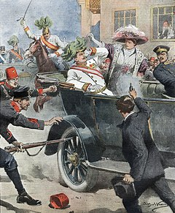

Slide 3
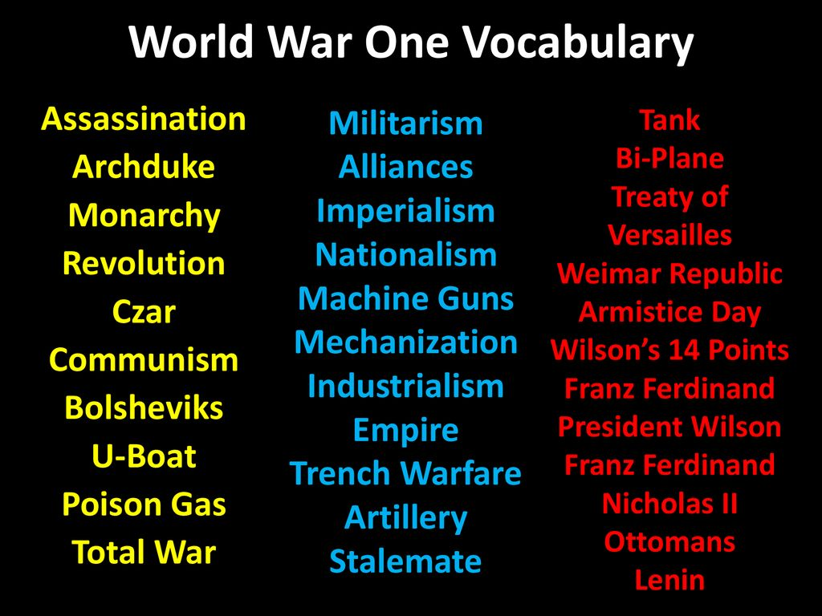

Slide 4
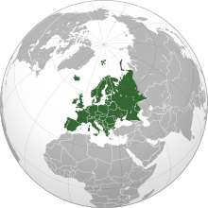
Social Studies Standards
SS6H3 Explain conflict and change in Europe.
a. Describe the aftermath of World War I: the rise of communism, the Treaty of Versailles, the rise of Nazism, and worldwide depression.

Slide 5
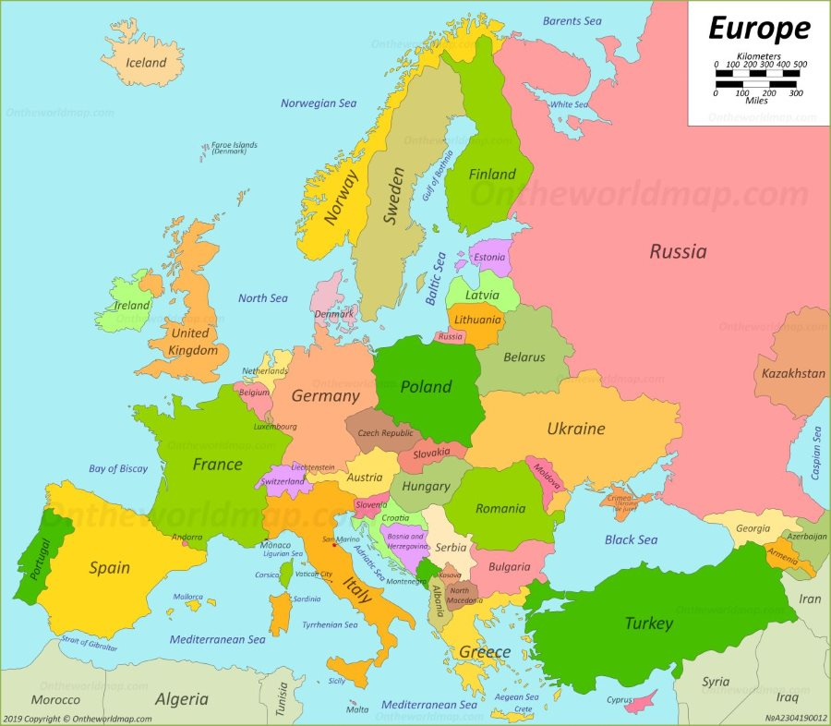
locate on a world and regional political-physical map the countries of France, Germany, Italy, Russia, Spain, Ukraine, and United Kingdom.

Slide 6
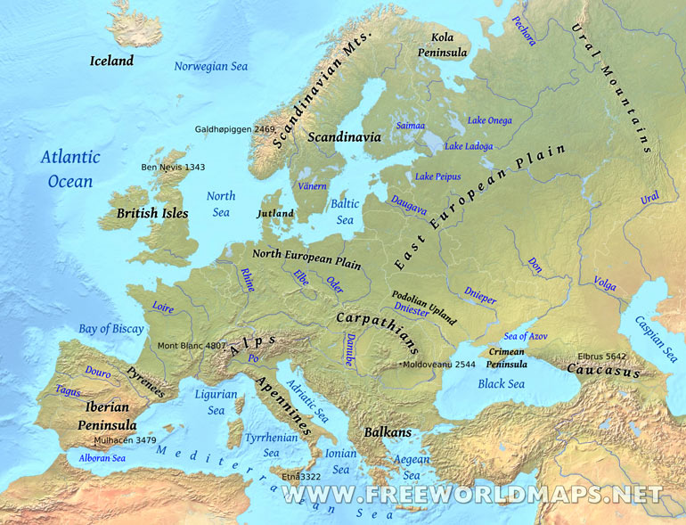
Locate on a world and regional political-physical map: the Danube River, Rhine River, English Channel, Mediterranean Sea, European Plain, the Alps, Pyrenees, Ural Mountains, and Iberian Peninsula.

Slide 7
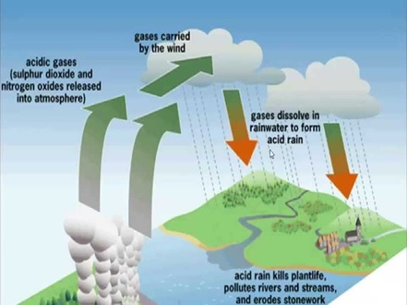
Acid Rain
Acid Rain In Germany Video
When it comes to the problem of acid rain, Germany is its own worst enemy. The main sources of acid rain are smoke from factories and cars. Factories burn fossil fuels like natural gas, coal, and oil. Cars and buses that burn gasoline and diesel produce these gases too. Germans also own more cars than most people do in other counties. This adds to acid rain through auto emissions.
SS6G8 Explain environmental issues in Europe.
a. Explain the causes and effects of acid rain in Germany. b. Explain the causes and effects of air pollution in the United Kingdom.
c. Explain the causes and effects of the nuclear disaster in Chernobyl, Ukraine.

Slide 8
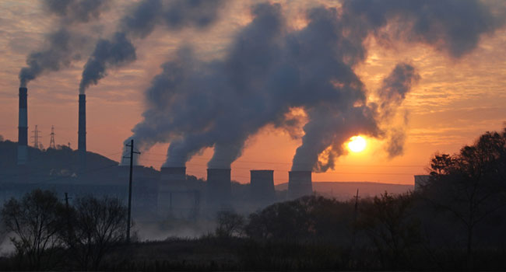
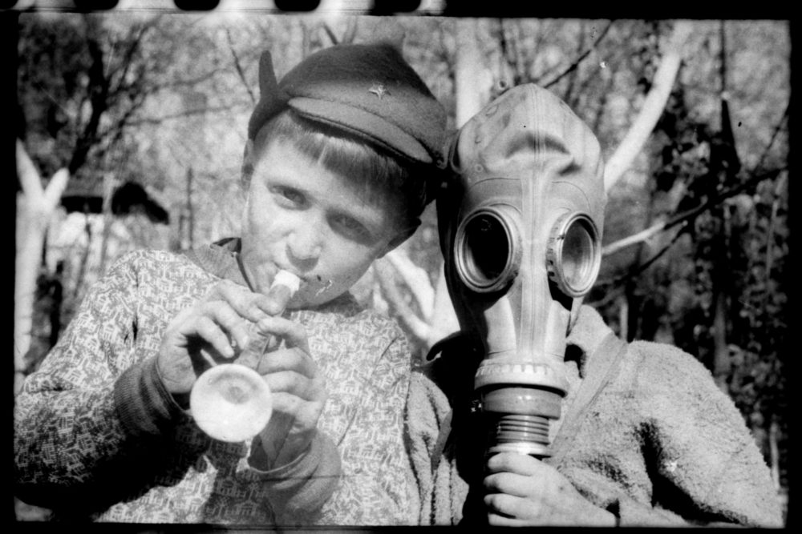
Air pollution in the UK is a major cause of diseases such as asthma, lung disease, stroke, cancer, and heart disease, and is estimated to cause forty thousand premature deaths each year, which is about 8.3% of deaths, while costing around £40 billion each year
On 26 April 1986, the Number Four reactor at the Chornobyl Nuclear Power Plant in what then was the Soviet Union during improper testing at low-power, resulted in loss of control that led to an explosion and fire that demolished the reactor building and released large amounts of radiation into the atmosphere. As safety measures were ignored, the uranium fuel in the reactor overheated and melted through the protective barriers.
SS6G8 Explain environmental issues in Europe.
a. Explain the causes and effects of acid rain in Germany. b. Explain the causes and effects of air pollution in the United Kingdom.
c. Explain the causes and effects of the nuclear disaster in Chernobyl, Ukraine.

Slide 9

Three Major Religions of Europe
Judaism Christianity Islam

Slide 10
Monday, September 26
Standard: SS6H3 Explain conflict and change in Europe. a. Describe the aftermath of World War I: the rise of communism, the Treaty of Versailles, the rise of Nazism, and worldwide depression.
Learning Target: I can explain the conflict in Europe (cause of WWI, Rise of Communism, Nazism, Depression, and Treaty of Versailles).
Warm-up: World War I Short Version (Video)
Work Session: Brain Wrinkles Slides and Cloze Notes. Textbook Ch.4 Sec.2 -3 Europe’s Expanding Influence; Modern Europe p.71-83.
Closing: Think-pair- Share
Reminders: History for kids | Happy LearningFIRST WORLD WAR | Educational Video for Kids

Slide 11
Tuesday, September 27
Standard: SS6H3 Explain conflict and change in Europe. a. Describe the aftermath of World War I: the rise of communism, the Treaty of Versailles, the rise of Nazism, and worldwide depression.
Learning Target: I can explain the conflict in Europe (cause of WWI, Rise of Communism, Nazism, Depression, and Treaty of Versailles).
Warm-up: World War I Short Version (Video) create a timeline foldable
Work Session: Brain Wrinkles Slides and Cloze Notes. Textbook Ch.4 Sec.2 -3 Europe’s Expanding Influence; Modern Europe p.71-83.
Closing: TOD
Reminders:

Slide 12
Wednesday, September 28
Standard: SS6H3 Explain conflict and change in Europe. a. Describe the aftermath of World War I: the rise of communism, the Treaty of Versailles, the rise of Nazism, and worldwide depression.
Learning Target: I can explain the conflict in Europe (cause of WWI, Rise of Communism, Nazism, Depression, and Treaty of Versailles).
Warm-up: World War I Short Version (Video) create timeline foldable
Work Session: Brain Wrinkles Slides and Cloze Notes. Textbook Ch.4 Sec.2 -3 Europe’s Expanding Influence; Modern Europe p.71-83.
Closing: Think-pair- Share
Reminders:

Slide 13
Thursday, September 29
Standard: SS6H3 Explain conflict and change in Europe. a. Describe the aftermath of World War I: the rise of communism, the Treaty of Versailles, the rise of Nazism, and worldwide depression.
Learning Target: I can explain the conflict in Europe (cause of WWI, Rise of Communism, Nazism, Depression, and Treaty of Versailles).
Warm-up: Why did the first World War break out (Video)
Work Session: Smaller Student Workbooks (Yellow). Color code world map of Central Powers vs Allied Powers; Board Game
Closing: TOD
Reminders: History for kids | Happy LearningFIRST WORLD WAR | Educational Video for Kids

Slide 14
Friday, September 30
Standard: SS6H3 Explain conflict and change in Europe. a. Describe the aftermath of World War I: the rise of communism, the Treaty of Versailles, the rise of Nazism, and worldwide depression.
Learning Target: I can explain the conflict in Europe (cause of WWI, Rise of Communism, Nazism, Depression, and Treaty of Versailles).
Warm-up: Why did the first World War break out (Video)
Work Session: Smaller Student Workbooks (Yellow). Color code world map of Central Powers vs Allied Powers; Board Game
Closing: Student Summary
Reminders:

Slide 15
Resources for Unit 1: Europe
0:39 / 4:59
History for kids | Happy Learning
FIRST WORLD WAR | Educational Video for Kids
2:35 / 30:26
Why Did The First World War Break Out? (July Crisis 1914 Documentary)

Slide 16
Resources for Unit 1: Europe
Countries of Europe
Physical Geography of Europe Part 1- Landforms and Waterways
17 Most Beautiful Countries in Europe – Travel Video

Slide 17
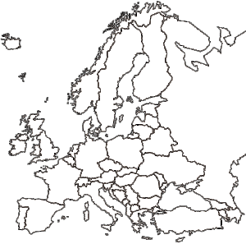

Slide 18
Social Studies Standards
SS6H3 Explain conflict and change in Europe.
a. Describe the aftermath of World War I: the rise of communism, the Treaty of Versailles, the rise of Nazism, and worldwide depression.
SS6G7 Locate selected features of Europe.
a. Locate on a world and regional political-physical map: the Danube River, Rhine River,
English Channel, Mediterranean Sea, European Plain, the Alps, Pyrenees, Ural Mountains,
and Iberian Peninsula.
b. Locate on a world and regional political-physical map the countries of France, Germany,
Italy, Russia, Spain, Ukraine, and United Kingdom.
SS6G8 Explain environmental issues in Europe.
a. Explain the causes and effects of acid rain in Germany.
b. Explain the causes and effects of air pollution in the United Kingdom.
c. Explain the causes and effects of the nuclear disaster in Chernobyl, Ukraine.
SS6G9 Explain the impact of location, climate, natural resources, and population distribution on Europe.
a. Compare how the location, climate, and natural resources of Germany, the United Kingdom and Russia impact trade and affect where people live.
SS6G10 Describe selected cultural characteristics of Europe.
a. Describe the diversity of languages spoken within Europe.
b. Identify the major religions in Europe: Judaism, Christianity, and Islam.
SS6CG3 Compare and contrast various forms of government.
a. Explain citizen participation in autocratic and democratic governments. [i.e., role of citizens in choosing the leaders of the United Kingdom (parliamentary democracy), Germany (parliamentary democracy), and Russia (presidential democracy)].
b. Describe the two predominant forms of democratic governments: parliamentary and presidential.
SS6E7 Analyze different economic systems.
a. Compare how traditional, command, and market economies answer the economic questions of 1-what to produce, 2-how to produce, and 3-for whom to produce.
b. Explain that countries have a mixed economic system located on a continuum between pure market and pure command.
c. Compare the basic types of economic systems found in the United Kingdom, Germany, and Russia.

Slide 19
SS6E8 Analyze the benefits of and barriers to voluntary trade in Europe.
a. Explain how specialization encourages trade between countries.
b. Compare and contrast different types of trade barriers such as tariffs, quotas, and embargoes.
c. Explain why international trade requires a system for exchanging currencies between nations.
d. Describe the purpose of the European Union and the relationship between member nations.
SS6E9 Describe factors that influence economic growth and examine their presence or
absence in the United Kingdom, Germany, and Russia.
a. Evaluate how literacy rates affect the standard of living.
b. Explain the relationship between investment in human capital goods (education and
training) and gross domestic product (GDP per capita).
c. Explain the relationship between investment in capital (factories, machinery, and
technology) and gross domestic product (GDP per capita).
d. Describe the role of natural resources in a country’s economy.
e. Describe the role of entrepreneurship.

